Slide 1
SWARM RESCUE BOTS SIMULATION
-Akshay R. Gurao.

Slide 2
Background & Key Issues
During emergencies, the victims trapped inside are very difficult to rescue by the fire-fighters.
The smoke can cause restricted visibility for the rescue squad.
Plus it becomes difficult when the area is very large.

Slide 3
Recommended Solution
In order to quicken the search and rescue operations, a swarm of bots can be used to quickly navigate and find the targets.
They can be used to provide accurate location for the rescue team or they themselves can be equipped for rescuing the people in need.
The bots implement the swarm algorithm in order to find the targets.

Slide 4
Algorithm Applied
Created a population of victims and bots uniformly distributed in the selected area.
Evaluated each bots position with respect to the victims and finding the nearest victim from the bot.
If the current bot position is better than the previous bot position then update the position.
Update the bot velocity and move them to new positions.
Go back to step 2 or stop when the target is reached.

Slide 5
Advantages of the Algorithm
Insensitive to scaling of design variables
Parallelized for concurrent processing.
Very few algorithm parameters.
Very efficient global search algorithm.

Slide 6
Disadvantages of the Algorithm
Tendency to a fast and premature convergence in mid optimum points.
Weak local search ability.

Slide 7
Simulation in Java
Plotted the bots and the victims uniformly in the space.
Started the search with 50 active bots continuously searching the nearest victims.
Finding the nearest victim and going to their location.

Slide 8
Objectives
Local Objective: Finding the nearest victim to save.
Global Objective: Marking all the victims as safe.

Slide 9
What I have achieved
Created a swarm of 50 active bots with attributes location, velocity and target.
Created a swarm of 50 stationary victims with attributes location and isSafe.
Initialized both the swarms by randomly generating the locations and velocity.
Tested the swarm to search and gather around a single victim with pre-defined location values.

Slide 10
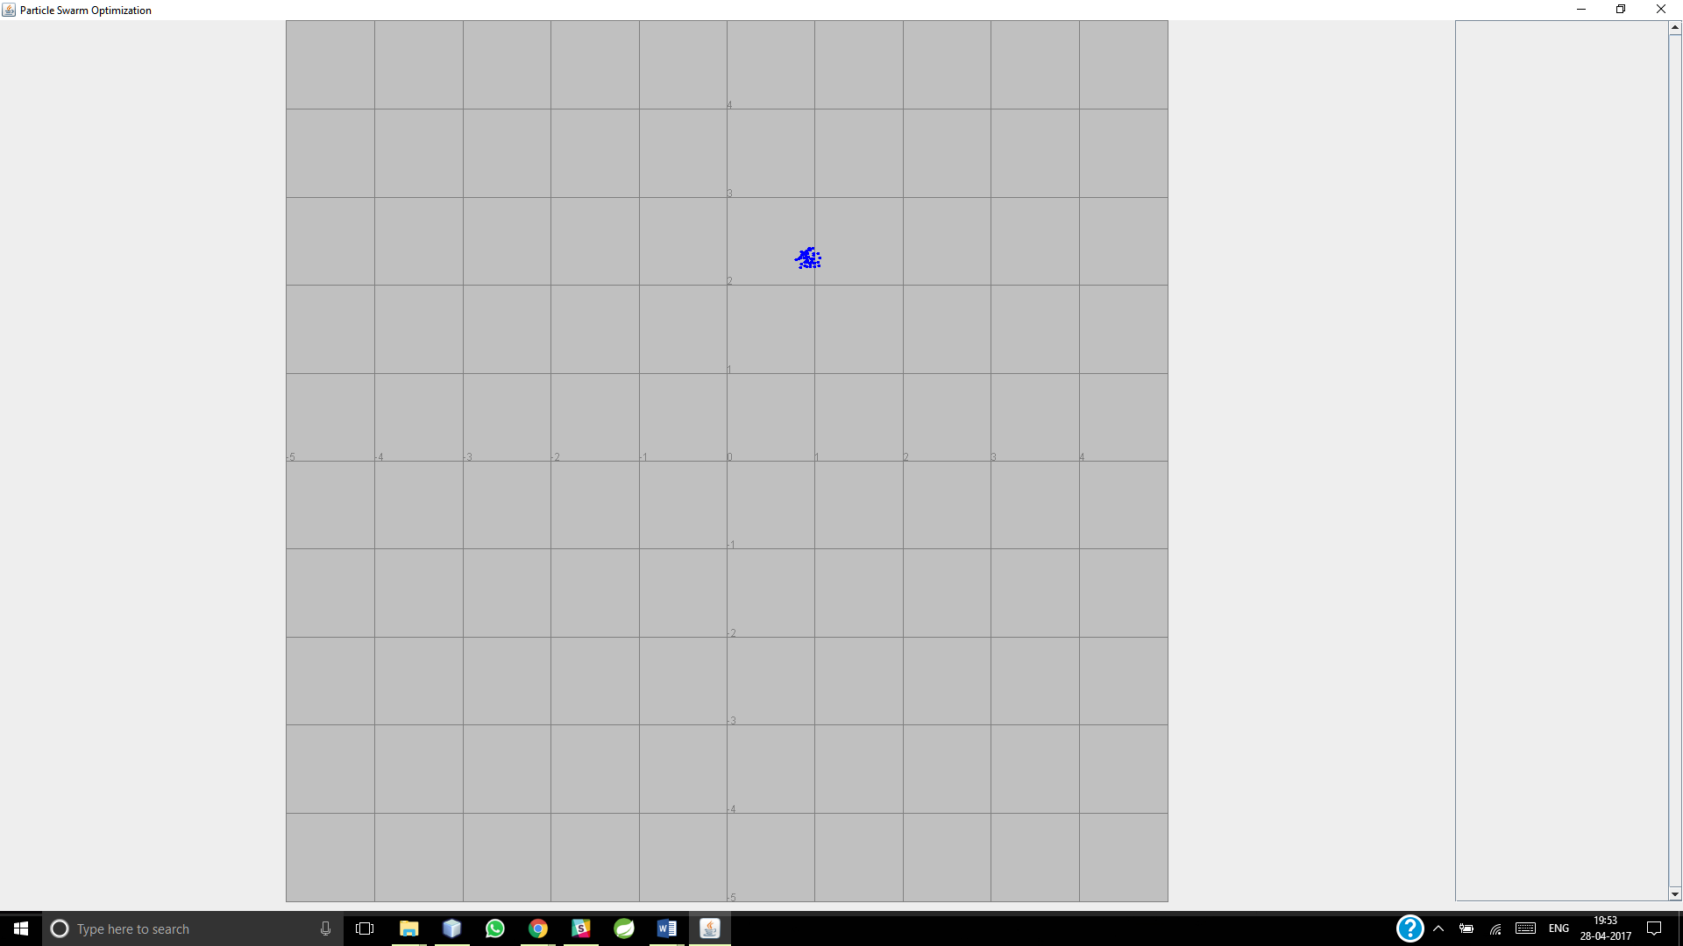
Simulation showing 50 active bots gathering around a pre-defined target.

Slide 11
Future Scope
Adding multiple search functionality for multiple victims.
Adding beautiful UI to show animation of moving bots towards the victims.

Slide 12
Thank you

